Slide 1
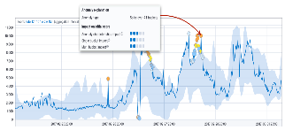

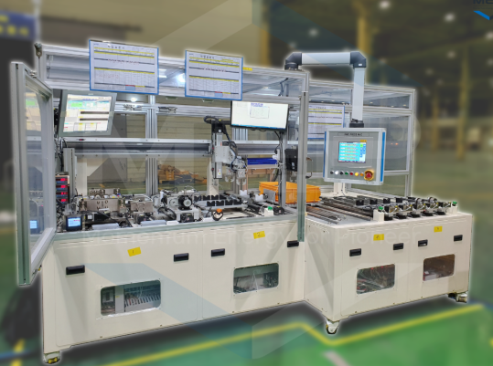
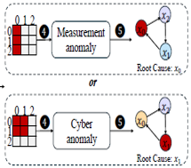
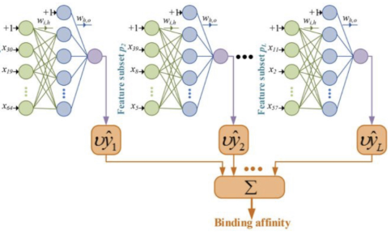

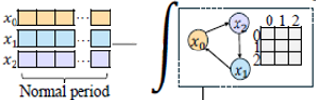
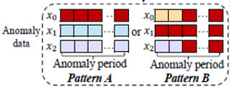

Appendix> Algorithm Process
Window Segmentation
Timeseries Transformation
Indicator Analysis
Indicator Identification
Check health status
[Real time Data]
[Sensor Embeddings]
[Select Optimal Indicator]
[Health Monitoring]
Health Score
(PASS or NG)
Sensor Error
# Physical Feature–Driven Diagnosis
1) Learn graph structure
or
- Top-k Nearest Neighbor Construction
Based on Cosine Similarity
- Sensor dependency graph
Parts
Failure
# We are currently testing
ensemble model
→ Graph-attention based model
+ Neural ODE based model +
Domain Logic + etc.
2) Neural ODE (Causality graph)
Fault Interpretation Based on Domain Logic
[Results]
[Fault Diagnosis]
[Multivariate Sensor Relationship Learning]

